Slide 1
Ch 8
Accounting for Limited Companies
(no book needed for this chapter only)

Slide 2
Corporate entity
The notion of corporate entity means that several people can band together as owners of a business by investing capital (resources or assets that are contributed to a business to help it grow or operate).
The business will be a legal entity separate from the owners (meaning it can own assets, incur liabilities, and enter into contracts independently of its owners).

Slide 3
Forms of capital and returns
Capital: resources or assets that are contributed to a business to help it grow or operate
What are the two sources of this capital?
What are the returns/rewards for contributing capital to a business?
A = L + O
Assets (A) are essential for running a business. The funds needed to acquire these assets typically come from two sources:
Liabilities (L) (e.g. loan)
Owner’s Equity (O) (portion of a company's assets that an owner can claim)

Slide 4
Liabilities (L)
CREDITOR: an individual or institution that lends money to another party, expecting repayment in the future. This repayment typically includes the original amount borrowed plus any agreed-upon interest.
Loan (e.g. from a bank): sum of money borrowed by corporations from a bank
As a reward for lending money to the corporation, creditor gets interest
Notes payable: written agreement in which one party lends money to another party in exchange of future repayment including interest
As a reward for lending money to the corporation, creditor gets interest
Bond: form of interest-bearing note payable issued by corporations
As a reward for lending money to the corporation, creditor gets interest
Debenture: debt instrument used by corporations to borrow money, at a fixed rate of interest
As a reward for lending money to the corporation, creditor gets interest
Mortgage: type of loan used to purchase or maintain a home, land, or other types of real estate
As a reward for lending money to the corporation, creditor gets interest
Long story short: loan, notes payable, bond, debenture, mortgage = corporation borrowing money from another entity and paying interest to that entity

Slide 5
Owner’s Equity (O)/ Stockholders’ Equity/ Shareholders’ Equity
The capital of a company is divided into shares which are purchased by investors, who then become shareholders/owners of the company (e.g. Grameenphone).
A person can become an owner of a corporation by purchasing one of two types of shares: Common Stock or Preferred Stock. The individual pays money to the corporation and receives shares/stock in exchange.
For a sole proprietorship, there is a single owner. When this owner invests money into the business, the funds go into an account called “Owner’s Capital”. Similarly, in a corporation with multiple owners, their collective capital is categorized as “Common Stock” or “Preferred Stock” meaning the money invested by them goes into an account called “Common Stock” (if they buy “Common Stock”) or into an account called “Preferred Stock” (if they buy “Preferred Stock”).
As a reward for investing in a sole proprietorship, the owner receives a profit. Likewise, in a corporation, shareholders (investors) receive dividends—a share of the profits—as a reward for investing.

Slide 6
Forms of capital and returns (summary)
L = Liabilities | O = Owner’s Equity (O)/ Stockholders’ Equity/ Shareholders’ Equity
Contributor: Creditor (e.g. bank) | Contributor: Owner/Stockholder/Shareholder
Types: Loan, Notes payable, Bond, Debenture, Mortgage | Types: Common Stock, Preferred Stock
Reward: Interest | Reward: Dividend

Slide 7
Financial statement formats
Now we will prepare the first 3 financial statements of a company
Financial statements:
Income statement
Stockholders’ Equity/ Shareholders’ Equity statement
Balance sheet
Cash flow statement (will be taught in higher level courses)

Slide 8
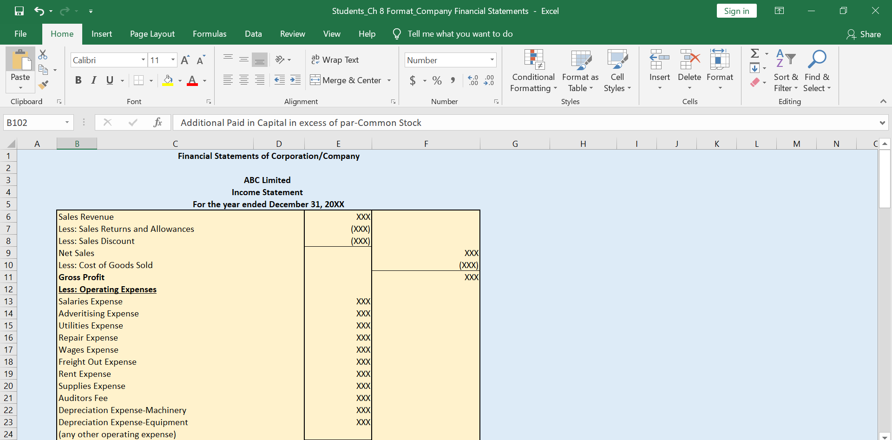
Financial statement formats (move to the Excel file)

